Slide 1
Introduction to Arm-based System-on-Chip Design

Slide 2
Module Syllabus
Why the SoC Concept Developed
Advantages and Limitations of SoCs
Differences among SoCs, CPUs and MCUs
SoC Design Flow
Examples of Commercialized SoCs

Slide 3
Why the SoC Design Concept Developed
We are living in a post-PC era, with:
Smartphones and tablets
The Internet of Things, wearable computing, and cyber-physical systems
Industry 4.0
The silicon transistor is still at the heart of this revolution.
The primary metrics of silicon chips have changed: from clock-frequency to cost, form-factor, and power.
On-chip integration of functional hardware is now more important than ever.
How and why have we reached this point?
Notes:
Smartphones and tablets, wearable computers and massively interconnected devices are being integrated into everything and are becoming everyday life objects. Mobility and autonomy are now as important as performance in modern electronic devices.

Slide 4
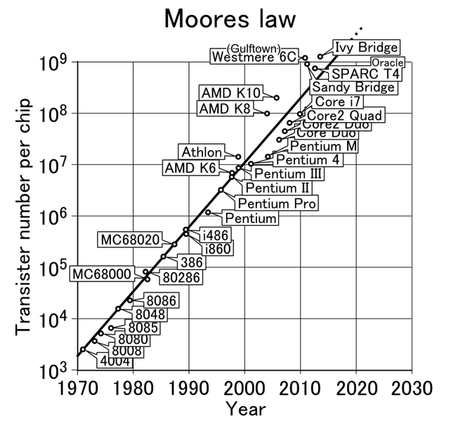
Moore’s Law
Moore’s Law
Prediction of Moore’s Law^{(*)}
(*) Data are based on international semiconductor technology road map (http://www.itrs.net/)
Notes:
In 1965, Intel co-founder Gordon E. Moore made an important observation famously known as Moore’s Law. He stated that the number of transistors on an integrated circuit for minimum component cost doubles every two years. Moore’s predictions have been proven to be correct and they are still considered one of the main driving forces in the development of semiconductor technologies.
As can be seen from this figure, the number of transistors integrated on one chip has already crossed the one billion mark.

Slide 5
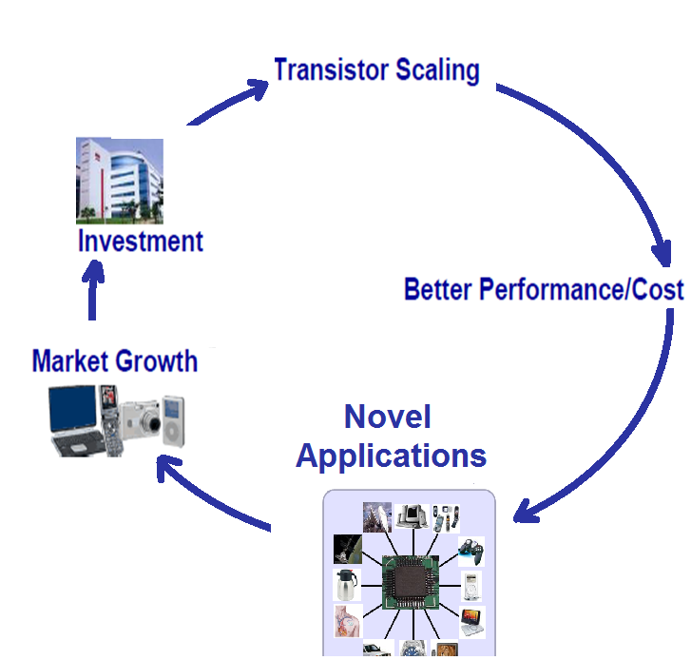
Why Scaling?
The virtuous circle of the semiconductor industry
Notes:
What has kept this trend going? In other words, what has driven the semiconductor industry to double the number of transistors on a chip every two years? The short answer is money.
In fact, in order to maintain this trend, the semiconductor technology has to shrink in size by 0.7 every generation. This is known as scaling, and means that, with every generation, one can integrate twice as many functions per chip. The chip fabrication itself does not increase significantly. This essentially means the cost of a function decreases by a factor of 2. Reducing the fabrication costs per function makes it feasible to design more sophisticated systems on a chip, which have enhanced performance.
The continuous development of better performance and cheaper semiconductor chips has led to the proliferation of these technologies in all corners of modern life. Nowadays, you can find semiconductor chips everywhere: in mobile phones, TVs, home appliances, cars, children’s toys, and even in the human body (e.g., pacemakers). This widespread use of the applications of semiconductor technologies leads to market growth. This lucrative industry reached the $250 billion mark by the year 2000. Some of this profit is typically used to develop new semiconductor devices that are smaller in size and cheaper in price, which in turn leads to the creation of more novel applications and an increase in the number of users, and hence the generation of more profit.
This the virtuous circle of the semiconductor industry has been going on for more than fifty years.

Slide 6
The Design Productivity Gap
Complexity outpaces design productivity
Notes:
But, how can we design chips with more functions? The design engineering population does not double every two years.
In this figure, the x-axis shows progression in time, while the y-axis has two lines: The upper line shows the rate of growth in chip complexity (as measured by the number of transistors per chip), while the lower line captures designer productivity (as measured by the average number of transistors designed by a staff engineer in a month).
The growth of design complexity outpaces design productivity. This is known as the design productivity gap.

Slide 7
Bridging the Design Productivity Gap
Several strategies exist to reduce the design productivity gap, namely:
Systems
on
Chips
Design Abstraction
Design Automation
Fast Prototyping
Design Reuse
Standard
Tools and Hardware Platforms
Notes:
To bridge the design productivity gap, we need to improve the productivity of IC design engineers in order to speed up the development time of systems. In fact, there exist several strategies to improve the productivity of design engineers, namely,
Design reuse: enhance design productivity by increasing the granularity of design library elements from standard cells to complex hardware and software functional blocks (e.g., custom accelerator and processor core).
Design abstraction allows the partitioning of the design process into a number of stages. At the top system level, the system specifications are decided in order to meet user’s requirements; in addition, at this stage, different architectures of the system are explored. The low-level implementation stages focus on the traditional logic/register transfer level (RTL) and physical design. Such partitioning of the design process helps reduce the time-to-market.
Design automation improves design productivity by automating some of the design tasks with the help of IC design tools.
Standardized tools and hardware platforms: this is crucial to allow quick prototyping of systems for evaluation and testing.
Fast Prototyping: SoC designs can be prototyped on FPGA for quicker verification of hardware, firmware and application software functionalities.

Slide 8
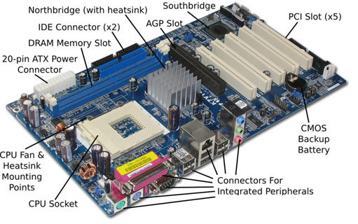
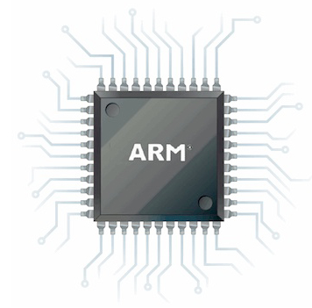
What Is an SoC?
An SoC is an integrated circuit that packages basic computing components into a single chip.
An SoC has most of the components to power a computer.
Arm cores
AMBA buses
Physical IPs
Motherboard of a PC
SoC
Picture source: http://thecustomizewindows.com/, http://www.adafruit.com/
Notes:
The application of the previous strategies, especially design abstraction, has led to the idea of SoC design framework.
What is an SoC? It is an integrated circuit designed by combining preexisting blocks (i.e., IPs or cores) to provide full functionality for a specific application such as mobile phones. The whole system is integrated on a single chip.
The figure above shows an Arm SoC that contains most of the components needed to power a computer.

Slide 9
What Is Inside an SoC?
System Master
(Processor)
System Bus
Program
Memory
Data
Memory
Timer
DAC
GPIO
Watchdog
Notes:
The basic components of an SoC include a system master, such as a microprocessor or DSP; system peripherals, such as a memory block, timer, or external digital/analogue interfaces; and a system bus that connects master and peripherals together using a specific bus protocol.
Modern SoCs also have more complicated architectures that may include digital signal processors, crypto cores, dedicated graphic processors, and so on. Therefore, the communication schemes used in these systems need to be more sophisticated than a simple bus. In these cases, the communication scheme consists of multiple buses with bridges or networks on chips.

Slide 10
Example Arm-based SoC
Clock
Generator
Power
Management Unit
Watchdog
JTAG/Serial wire
Arm Cortex-M0
Microprocessor
DMA
Low Latency
AHB IOP
Timers
Mux
APB Bus
AHB to APB
Bus Bridge
UART
ARM AMBA 3 AHB-Lite System Bus
Arm AMBA 3 AHB-Lite System Bus
RAM
System
Control
UART
ROM
VGA
Boot
ROM
RAM
GPIO
ROM
Table
Timer
AHB
Peripheral
7-segment
Display
APB
Peripheral
An example of an Arm-based SoC
Notes:
A basic Arm-based SoC usually consists of an Arm processor, such as the Cortex-M0; advanced microcontroller bus architecture (AMBA), e.g., AMBA3 or AMBA4; and physical IPs (or peripherals) from Arm or third parties.
Additionally, some SoCs may have a more advanced architecture, such as a multi-bus system with a bus bridge, DMA engine, clock and power management, etc.

Slide 11
Advantages of SoCs
SoC
Advantages
Higher performance
Lighter footprint
Power efficiency
Higher reliability
Low cost
Notes:
Compared to conventional systems on boards, the integration of a whole system on a single chip provides numerous advantages, namely:
Higher performance: the dense integration of system blocks on the same chip will reduce the length of wires needed to connect them together; this, in turn, reduces wire propagation delay, hence improving the whole system performance.
Power efficiency: this is achieved because the voltage required for SoCs is (typically <2.0 volts) lower compared with external chip voltage (typically >3.0 volts) needed for systems on boards. Another reason for power efficiency is the fact that intra-chip wires have less capacitance than inter-chips wires.
Lighter footprint: the device size and weight is reduced as all system blocks are integrated on the same chip.
Higher reliability: this is mainly due to the fact that all system clocks are encapsulated in a single chip package and therefore better protected against interference and noise from the external world.
Low cost: the cost per unit is reduced since a single chip design can be fabricated in large volumes.

Slide 12
Limitations of SoCs
SoC Limitations
Less flexibility
Complexity
Application specific
Notes:
The SoC design framework has a number of limitations, mainly because it is not possible to replace individual blocks in an SoC, so you may need to replace the whole chip if there is a faulty sub-circuit. Moreover, the access to the individual blocks from the chip external pins is very limited. The limitations of SoCs can be summarized as follows:
Less flexibility: unlike a PC or a laptop, which allows you to upgrade a single component, such as RAM or a graphic card, an SoC cannot be easily upgraded after manufacture.
Application specific: most SoCs are specific to particular applications; thus, they are not easily adapted to other applications.
Complexity: an SoC design usually requires advanced skills compared with board-level development:
The development of a whole system on a single chip requires the designers to employ a number of different design flows: custom design flow, mixed signal design flow, and standard cell design flow. They also need to integrate a number of digital and analogue blocks on the same die. This can be especially challenging due to inter-blocks interference, which may affect the reliability and performance of the system. For example, digital blocks such as processors usually run on very high frequencies. Some of these high-frequency signals may interfere with the clock generator (an analogue block) through the silicon substrate. This leads to clock jitter, which may cause timing errors and/or degraded performance.
SoC is typically built using cores from different vendors. The integration of these in one system requires a lot of expertise in order to design reliable interfaces.
Testing an SoC design is also a challenging and complex task. This usually requires a careful integration approach to make sure different blocks communicate correctly together and do not affect each other’s performance and reliability.

Slide 13
SoC v Microcontroller v Processor
SoC
Can have a single or multiple processor cores
CPU
Is a single processor core
MCU
Has larger memory blocks, a variety of IOs, and other peripherals
Integrated with more powerful blocks, e.g., GPU, DSP
Capable of running OSs
Mainly used for advanced applications (e.g., smartphones, tablets).
Used for general purposes
It needs to be supported with memories and IOs
Mainly used for basic control purposes, such as embedded applications
Has memory blocks, basic IOs, and other basic peripherals
Typically has a single processor core
Notes:
It is important at this stage to clarify the differences between SoC, CPU, and MCU. They are all implemented on a single chip package, but have some differences. This slide shows a comparison of their important features.

Slide 14
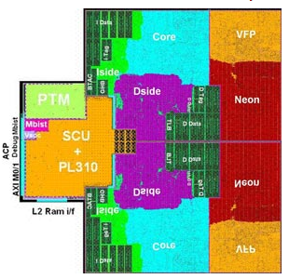
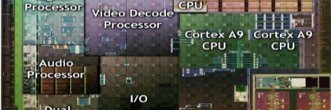
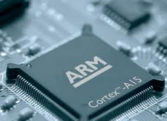

SoC Design Flow
SoC
Design Specifics
Hardware
IP Cores
Software
Drivers
IP Vendors:
Core Design
Purchase HW Cores
Purchase SW Drivers
Architecture Design
HW/SW Partitioning
Integrated
Hardware
Integrated
Software
Fabless Vendors: SoC Design
Functional
Simulation
Prototype on Platforms
e.g., FPGA
Software
Simulation
Physical Optimization
and Fabrication
HW/SW
Co-verification
Application Development
and Test
Foundries:
Chip Fabrication
Volume Manufacture
and Ship
Device Vendors:
Final Products
PCB Manufacture
and Device Assembly
Notes:
In a typical SoC design flow, there are a set of key steps to be undertaken from specification to final packaging. In reality, the design process is more complicated, partly concurrent with iterative loops. IC design tools are integral to this process.

Slide 15

SoC Design Flow
SoC
Design Specifics
Hardware
IP Cores
Software
drivers
IP Vendors:
Core Design
Purchase HW Cores
Purchase SW Drivers
Architecture Design
HW/SW Partitioning
Integrated
Hardware
Integrated
Software
Fabless Vendors: SoC Design
Functional
Simulation
Prototype on Platforms
e.g., FPGA
Software
Simulation
Physical Optimization
and Fabrication
HW/SW
Co-verification
Application Development
and Test
Foundries:
Chip Fabrication
Volume Manufacture
and Ship
Device Vendors:
Final Products
PCB Manufacture
and Device Assembly
Notes:
At the SoC specifications stage, the user requirements are identified. These include, but are not limited to, the system’s functionality, modes of operation, size, and performance.
The next stage is to create a gold model of the system using high-level programming language C. Such a model is refined a number of times until it satisfies all of the user’s requirements. The high-level behavioral mode of the system is then used as a “gold standard”. All other system models developed at later stages of the design cycle must satisfy the gold standard. Due to these specs being developed during the initial design phase, they require continuous refinement as the design progresses. In addition, at this stage, a work plan is developed, with tasks, timeline, and milestones (schedule) for the rest of the design process.

Slide 16
SoC Design Flow
SoC
Design Specifics
Hardware
IP Cores
Software
Drivers
IP Vendors:
Core Design
Purchase HW Cores
Purchase SW Drivers
Architecture Design
HW/SW Partitioning
Integrated
Hardware
Integrated
Software
Fabless Vendors: SoC Design
Functional
Simulation
Prototype on Platforms
e.g., FPGA
Software
Simulation
Physical Optimization
and Fabrication
HW/SW
Co-verification
Application Development
and Test
Foundries:
Chip Fabrication
Volume Manufacture
and Ship
Device Vendors:
Final Products
PCB Manufacture
and Device Assembly
Notes:
At this stage, the system architect decides on the software and hardware partitions to determine which functions should be carried out by the hardware and which should be performed by the software applications. In addition, he defines the interface and protocols between the hardware and software.
The partitioning of the system into hardware and software elements can help speed up the design process, as it allows parallelizing work among team members. At this design stage, third-party hardware IP cores and software drivers that are needed to realize the system are also identified and sourced from the appropriate vendors.

Slide 17
SoC Design Flow
SoC
Design Specifics
Hardware
IP Cores
Software
Drivers
IP Vendors:
Core Design
Purchase HW Cores
Purchase SW Drivers
Architecture Design
HW/SW Partitioning
Integrated
Hardware
Integrated
Software
Fabless Vendors: SoC Design
Functional
Simulation
Prototype on Platforms
e.g., FPGA
Software
Simulation
Physical Optimization
and Fabrication
HW/SW
Co-verification
Application Development
and Test
Foundries:
Chip Fabrication
Volume Manufacture
and Ship
Device Vendors:
Final Products
PCB Manufacture
and Device Assembly
Notes:
At this stage, a hardware prototype of the system is implemented on a field-programmable gate array (FPGA) board. In some cases, the system prototype is built on a dedicated silicon chip. This implementation stage can be generally divided into three phases: functional, circuit, and physical.
At the functional design stage, the behavioral model of the hardware is created together with a working prototype of the software.
At the circuit design stage, the behavioral descriptions of the functional blocks are transferred into circuits. For digital blocks, this process is automated and based on synthesis algorithms. For analog blocks, this has to be done by hand; research is ongoing for automating the analog design process.
At the physical design phase, main design tasks include floor planning, pad ring design, placement, clock tree design, power and IR drop analysis (dynamic and static), routing, and design rule checks. It is worth mentioning here that as the semiconductor technologies become smaller, the design-level stage becomes more complicated and may require additional tools for timing and power analysis. Detailed functional simulation and software verification are usually performed after each step of this implementation process.

Slide 18
SoC Design Flow
SoC
Design Specifics
Hardware
IP Cores
Software
Drivers
IP Vendors:
Core Design
Purchase HW Cores
Purchase SW Drivers
Architecture Design
HW/SW Partitioning
Integrated
Hardware
Integrated
Software
Fabless Vendors: SoC Design
Functional
Simulation
Prototype on Platforms
e.g., FPGA
Software
Simulation
Physical Optimization
and Fabrication
HW/SW
Co-verification
Application Development
and Test
Foundries:
Chip Fabrication
Volume Manufacture
and Ship
Device Vendors:
Final Products
PCB Manufacture
and Device Assembly
Notes:
Once the system has been implemented, it is important to run cosimulation of hardware and software in order to allow these components to be refined. This verification stage is an iterative process and it sometimes requires additional software development and hardware optimizations.

Slide 19
SoC Design Flow
SoC
Design Specifics
Hardware
IP Cores
Software
Drivers
IP Vendors:
Core Design
Purchase HW Cores
Purchase SW Drivers
Architecture Design
HW/SW Partitioning
Integrated
Hardware
Integrated
Software
Fabless Vendors: SoC Design
Functional
Simulation
Prototype on Platforms
e.g., FPGA
Software
Simulation
Physical Optimization
and Fabrication
HW/SW
Co-verification
Application Development
and Test
Foundries:
Chip Fabrication
Volume Manufacture
and Ship
Device Vendors:
Final Products
PCB Manufacture
and Device Assembly
Notes:
Once all aspects of the system‘s specifications have been verified, the prototype can be sent to the chip fabrication foundry for mass production.

Slide 20
SoC Design Flow
SoC
Design Specifics
Hardware
IP Cores
Software
Drivers
IP Vendors:
Core Design
Purchase HW Cores
Purchase SW Drivers
Architecture Design
HW/SW Partitioning
Integrated
Hardware
Integrated
Software
Fabless Vendors: SoC Design
Functional
Simulation
Prototype on Platforms
e.g., FPGA
Software
Simulation
Physical Optimization
and Fabrication
HW/SW
Co-verification
Application Development
and Test
Foundries:
Chip Fabrication
Volume Manufacture
and Ship
Device Vendors:
Final Products
PCB Manufacture
and Device Assembly
Notes:
Finally, the fabricated SoCs are sent to PCB manufacture for device assembly, which will be part of the final product.

Slide 21
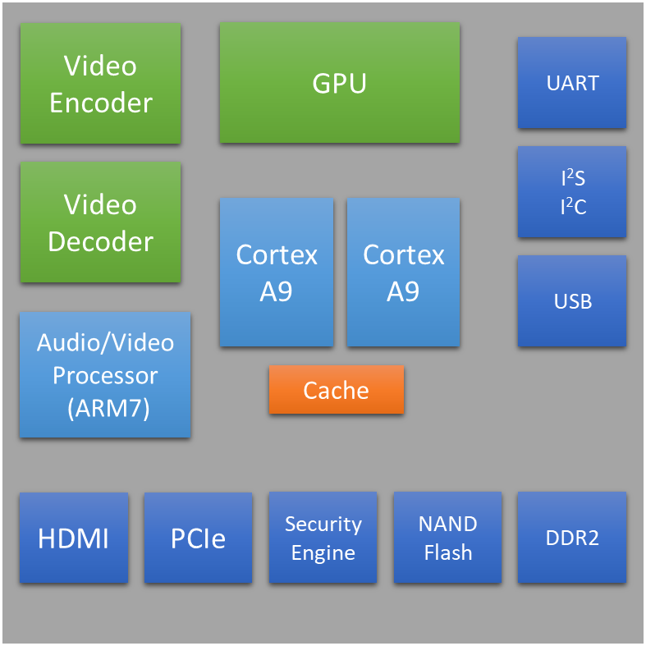
SoC Example: NVIDIA Tegra 2
Designer | NVIDIA
Year | 2010
Processor | Arm Cortex-A9 (dual-core)
Frequency | Up to 1.2 GHz
Memory | 1 GB 667 MHz LP-DDR2
Graphics | ULP GeForce
Process | 40 nm
Package | 12 × 12 mm (package on package)
Used in tablets | Acer Iconia Tab A500 Asus Eee Pad Transformer Motorola Xoom Motorola Xoom Family Edition Samsung Galaxy Tab 10.1 Toshiba Thrive
Notes:
Benefiting from their power efficiency, SoCs have been widely used in mobile devices, such as smartphones, tablets, and digital cameras. Most mobile SoCs use Arm-based microprocessors since they deliver high performance with less power consumption.
An example of a commercialized SoC is the NVIDIA Tegra 2, which is used in a number of tablets such as the Acer Iconia Tab A500 and the Motorola Xoom. It is based on the Arm Cortex-A9 dual-core processor. The diagram here shows the system architecture of the NVIDEA Tegra 2. Other examples of Arm-based SoCs include Ax by Apple and Snapdragon by Qualcomm.

Slide 22



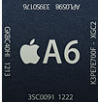



SoC Example: Apple SoC Families
SoC | Model No. | CPU | CPU ISA | Technology | Die size | Date | Devices
N/A | APL0098 | Arm11 | Armv6 | 90 nm | N/A | 6/2007 | iPhone iPod Touch (1st gen.)
A4 | APL0398 | Arm Cortex-A8 | Armv7 | 45 nm | 53.29 mm² | 3/2010 | iPad, iPhone 4, Apple TV (2nd gen.)
A5 | APL0498 | Arm Cortex-A9 | Armv7 | 45 nm | 122.6 mm² | 3/2011 | iPad 2, iPhone 4S
 | APL2498 | Arm Cortex-A9 | Armv7 | 32 nm | 71.1 mm² | 3/2012 | Apple TV (3rd gen.)
 | APL7498 | Arm Cortex-A9 | Armv7 | 32 nm | 37.8 mm² | 3/2013 | Apple TV 3
A5X | APL5498 | Arm Cortex-A9 | Armv7 | 45 nm | 162.94 mm² | 3/2012 | iPad (3rd gen.)
A6 | APL0598 | Swift | Armv7s | 32 nm | 96.71 mm² | 9/2012 | iPhone 5
A6X | APL5598 | Swift | Armv7s | 32 nm | 123 mm² | 10/2012 | iPad (4th gen.)
A7 (64-bit) | APL0698 | Cyclone | Armv8-A | 28 nm | 102 mm² | 9/2013 | iPhone 5S, iPad mini (2nd gen.)
 | APL5698 | Cyclone | Armv8-A | 28 nm | 102 mm² | 10/2013 | iPad Air
Notes:
Arm-based SoCs are also used to build a number of Apple devices such as iPhone, iPad, and Apple TV.

Slide 23
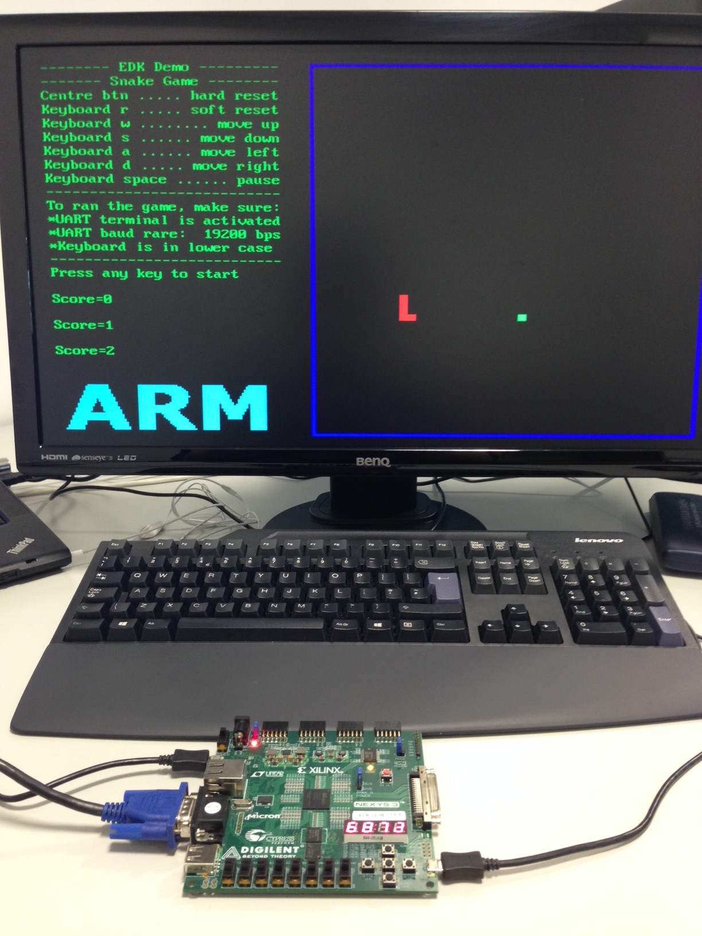
Course Summary
In the following modules, you will be:
Learning about Arm Cortex-M0 processor architecture and AMBA3 AHB bus protocol
Implementing a basic Arm-based SoC using Cortex-M0 and AHB bus and prototype them onto an FPGA chip
Developing your own hardware peripherals
Developing software drivers for your physical IPs
Demonstrating your SoC through a game application (the SNAKE game as shown in the picture on the right)

Slide 24
Useful Resources
Throughout this course, if you want to dig deeper, you can consult the references below.
L.E.M. Brackenbury, Plana, L.A., and Pepper, J., 2010. “System-on-Chip Design and Implementation,” IEEE Transactions on Education 53, no.2 (May).
Steve Furber, Arm System-on-chip Architecture, (London: Addison Wesley, 2000).
Joseph Yiu, The Definitive Guide to the ARM Cortex-M0, (Amsterdam: Newnes, 2011).
Arm AMBA 3 AHB-Lite Protocol Specification
Arm Cortex-M0 Devices Generic Users Guide
Arm Cortex-M0 Technical Reference Manual
ARM v6-M Architecture Reference Manual
Nexys3 Board Reference Manual

